Slide 1
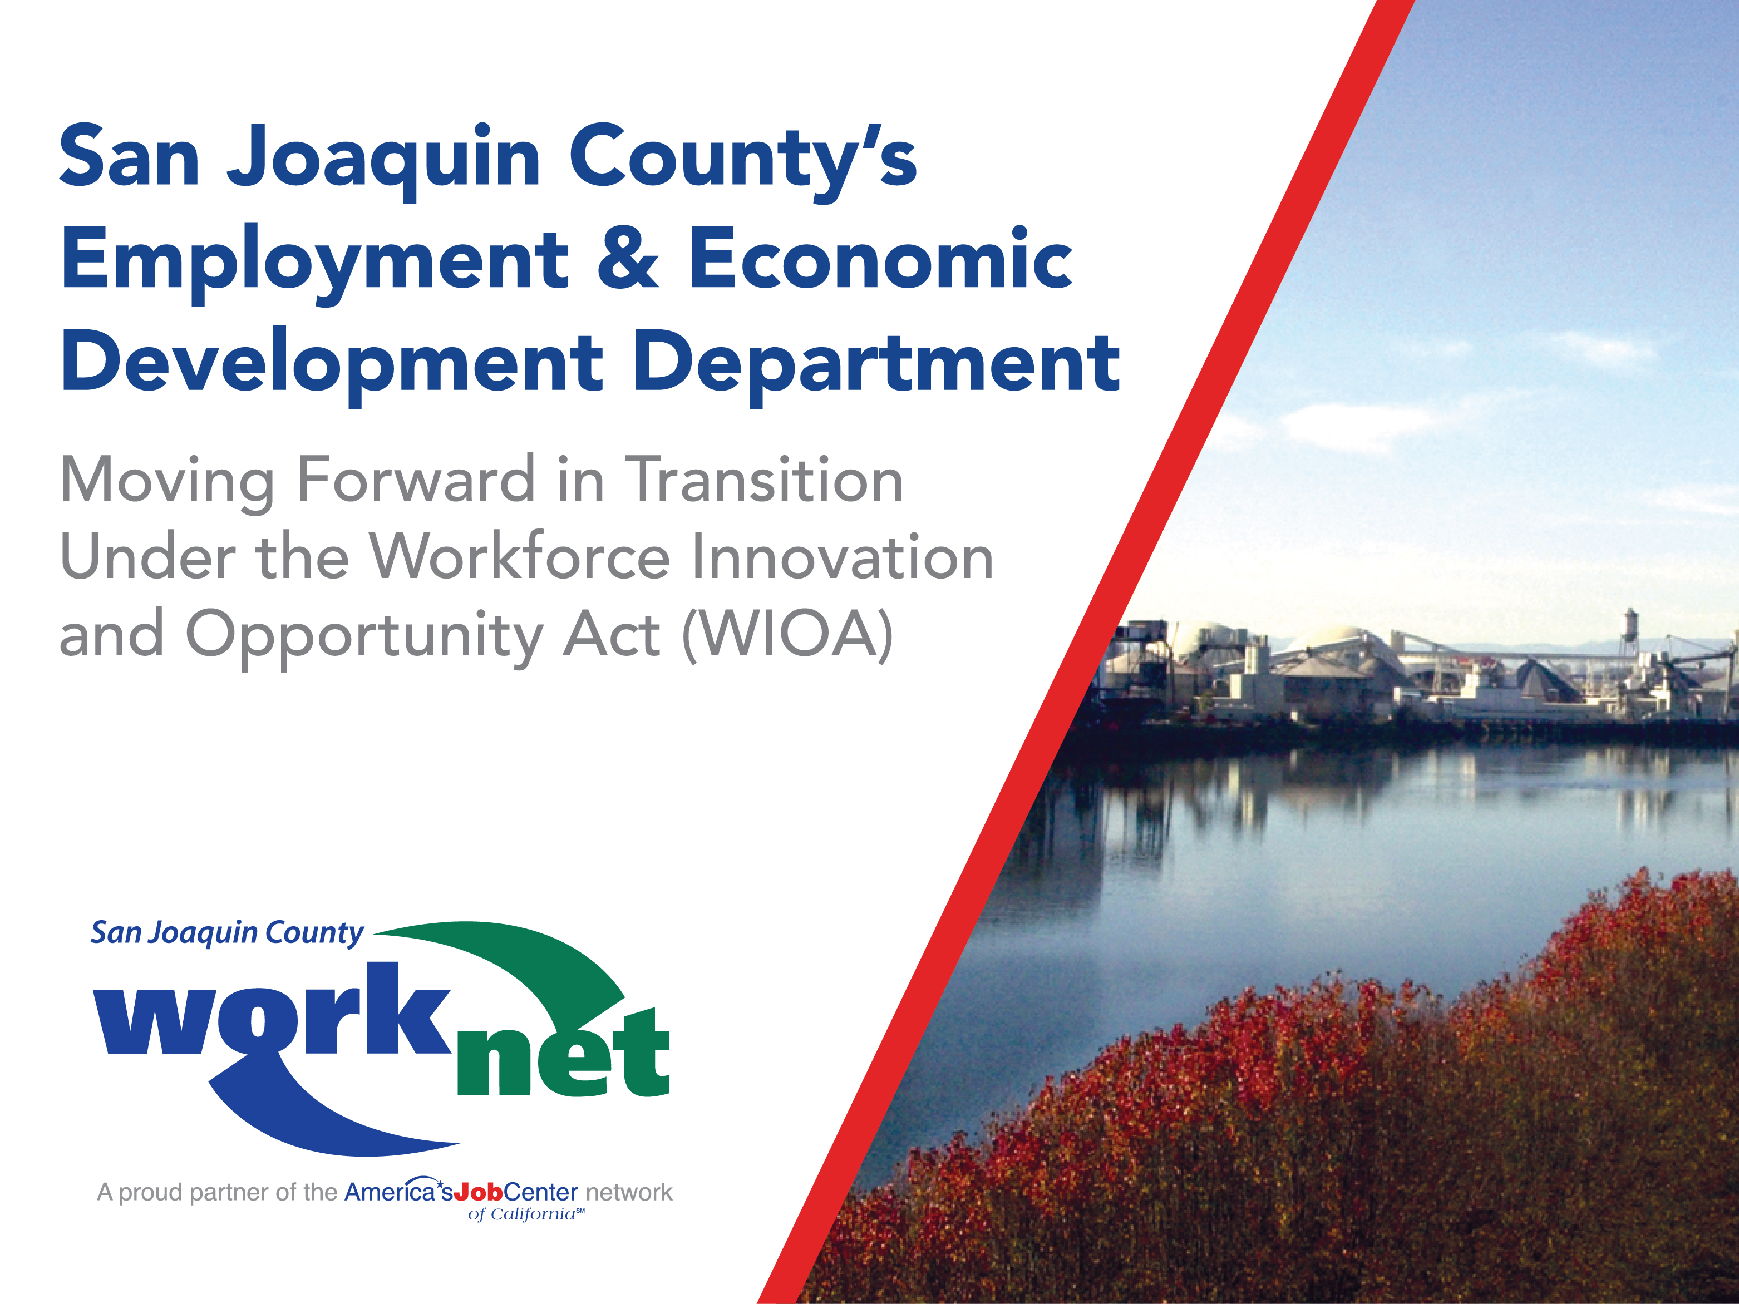
BOS Department Presentation - 1/23/2018
Notes:
San Joaquin County’s
Opening Slide
Mr. Chairman, members of the Board,
Thank you for the opportunity to come before you to give you a brief overview of what EEDD has accomplished this past year.

Slide 2




San Joaquin County’s
Employment and Economic
Development Department
Workforce Development Board
Revolving Loan Fund Board
Economic Development Association
Notes:
The Employment and Economic Development Department is the Administrative entity and Fiscal Agent, charged with the responsibility of oversight of three critical programs.
EEDD is staff to:
WDB – the leading entity for Workforce Development
RLFB – Financing Small Business Development & Business Expansion in San Joaquin County
EDA – with its Business Retention and Expansion Program (BREP) and an engaged partner in Industry Attraction

Slide 3


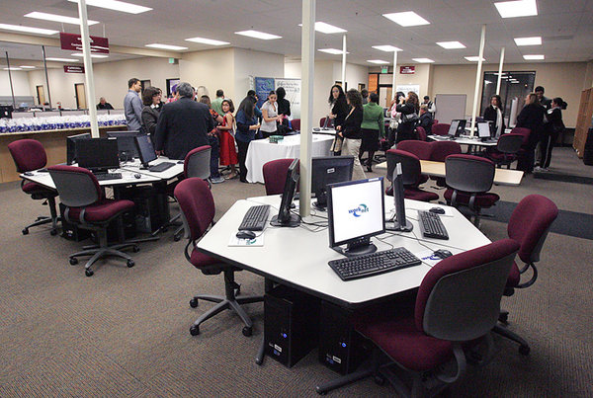

Workforce Development Board
The One-Stop Service Delivery System in
San Joaquin County… For Workforce Development
On the internet @ www.sjcworknet.org
Notes:
San Joaquin County WorkNet is the primary organization for Workforce Development funded under WIOA. It is the WDB’s One-Stop Service Delivery System in San Joaquin County for Workforce Development.

Slide 4

Workforce Development Board
Two Primary Responsibilities…
1. Workforce Development
  Provide employment and training services and opportunities to the job seekers in San Joaquin County.
2. Business Development
  Support the business community by helping business access available resources and services that will promote business growth and encourage employment opportunity.
Notes:
By making available the services and resources that will eliminate barriers to employment and increase their employability and help them find the jobs that promote self-sufficiency.

Slide 5
Workforce Development Board
Mission Statement
It is the mission of the San Joaquin County
Workforce Development Board
to take the leadership role in…
“Bringing together the resources of the community to help job seekers find the right jobs and help employers meet their business needs.”

Slide 6
San Joaquin County WorkNet
Objective
Establish a full service delivery system working in partnership with our community through strong collaboration; we are consolidating and leveraging available resources to more effectively serve our common customers.
• The Job Seeker looking for work and
• Businesses that hire them

Slide 7
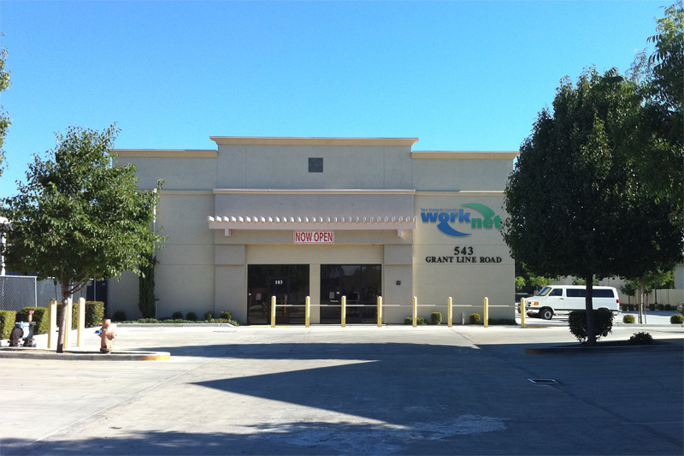
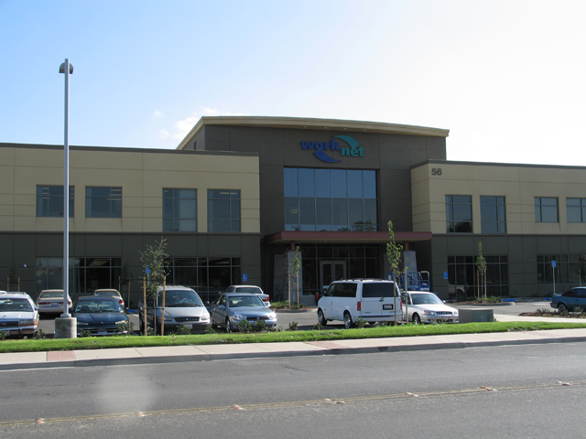
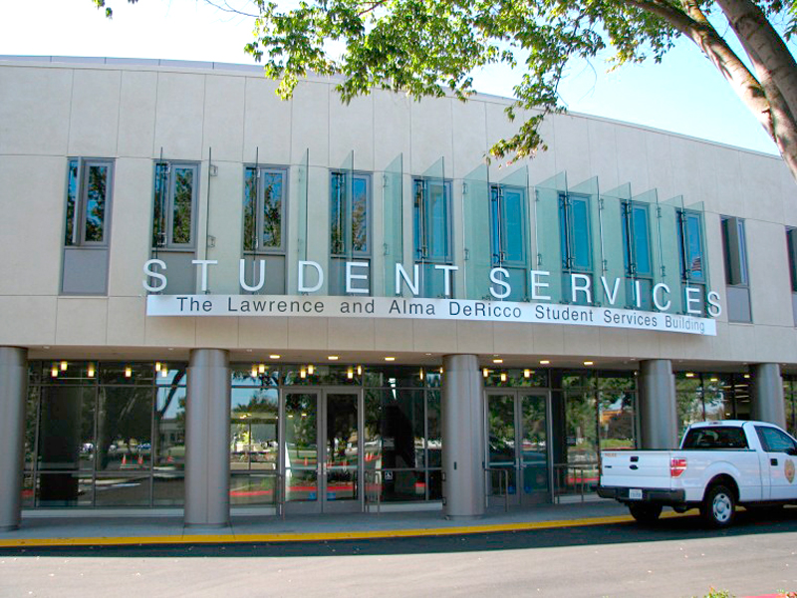
San Joaquin County WorkNet:
Has Five WorkNet Centers in:
CHD WorkNet Center in Lodi
  631 E. Oak St.
Stockton WorkNet Center
  56 S. Lincoln St.
Delta WorkNet Center
  DiRicco Student Service Bldg.
  5151 Pacific Ave.
Manteca Adult School Campus
  2271 W. Louise Ave.
Tracy WorkNet Center
  543 W. Grant Line Rd.
Notes:
Last year, EEDD received notification that State EDD was closing the Manteca WorkNet Center located at Northgate Avenue.
The year before due to reduced funding and increased operational cost
Lease was approximately $250 K
Operational cost for five (5) State employees was approximately $850 K
State EDD wanted us to find a smaller location and talk to Partner Agencies to consider moving into the Manteca WorkNet facility.
Diane Medeiros, Principal of the Manteca Adult School, extended an invitation to relocate into the Manteca Adult School campus which is the home of:
MUSD Administration
(4) Charter Schools
Hub for Career Technical Education- Welding, Forklift
SJ Delta College was already conducting classes
Manteca Adult School
Upon receipt of the notification from State EDD of the Manteca WorkNet Center closure, we initiated the development of a new affiliated center at the Manteca Adult School – with No Cost for lease
We developed a MOU – Finalized late summer and initiated the move in September.

Slide 8
San Joaquin County WorkNet
One-Stop WorkNet Center Services
Adult Services | PY 2016 | PY 2017
Job Seekers Served | 52,808 | 50,062
Job Seekers Services | 91,698 | 78,744
Total Enrollments | 2,262 | 1,691
Participating Employers | 268 | 245
WIOA EE Rate WIA EE Rate | 71.81% 85% | 70.25%
Notes:
SJC WorkNet Center Performance
The following are performance stats for FY 2016 & 2017
Performance Standards have changes:
State follow-up is now in the fourth (4) quarter after exit vs the second (2) quarter after exit:
WIOA puts a strong focus on serving the high risk population with multiple barriers to employment.
Individuals with disabilities
Unemployed veterans
English learners
EE rates went from 85% under WIA to 71% under WIOA

Slide 9


We are on the Internet…
Using the internet as a channel of communication to bring information and resources to our clients in San Joaquin County
www.sjcworknet.org
PY 2017: 275.773 Users/3.6 Million Hits
Notes:
Through the internet our customers can access our Partners and resources and initiate our conversations.
Following their initial visit to one of our WorkNet Centers and the orientation, customers can access the resources and continue their Job Search on-line.

Slide 10


WorkNet Partners
Employer Services
Job Seeker Services
WorkNet Announcements
WorkNet News
WorkNet Center Information
Notes:
On the Internet with a click of a button job seekers and employers have access to a variety of resources and information.

Slide 11





Our partners include...
State Employment Development Department
San Joaquin County Office of Education
San Joaquin Delta College
Human Services Agency
Employment & Economic Development Department
Greater Stockton Chamber of Commerce
Economic Development Association
Department of Rehabilitation
Central Valley Asian-American Chamber of Commerce
Northern California Carpenters Regional Council
San Joaquin Partnership
California Human Development
Candelaria American Indian Council
Housing Authority of San Joaquin County
Laborers Union, Local 73
Just Say No, Stockton, Inc.
African American Community Service
Job Corps

Slide 12

The New WIOA Legislation
Workforce Development Reauthorization
Signed into Law on July 22,2014
Reauthorizes the Workforce Development Board and the One-Stop Center Service Delivery System
Replacing the Workforce Investment Act of 1998
Notes:
The critical challenge across this country and throughout the State of California was the implementation of the New WIOA legislation and 1800 hundred pages of Federal Regulations and Federal and State directives that have been coming out on a monthly basis. Sometimes as many as three (3) in one month.

Slide 13

Workforce Innovation and Opportunity Act Implementation
Early implementation was initiated July 1, 2015
Actual Implementation Started July 1, 2016
Will Continue through June 30, 2018

Slide 14

San Joaquin County’s
Workforce Development Board
Will Consist of…
15 Business Representatives
11 Required Partners*
3 Local Optional Partners
Membership Totaling 29
*May represent more than one program

Slide 15

Representation of San Joaquin County’s
Workforce Development Board
Will Consist of…
15 Business Organizations (R)
4 Labor Representatives (R)
1 Apprenticeship Program (R)
1 CBO Serving Target Groups (O)
1 Youth Serving Organization (O)
1 Adult Education and Literacy (R)
1 Higher Education and Literacy (R)
1 Economic and Community Development (R)
1 Wagner-Peyzer Program (R)
1 Title IV Vocational Rehabilitation (R)
1 Public Assistance / CalWORKS (R)
1 San Joaquin Probation (O)

Slide 16

Application for Initial Area Designation and Board Certification
Requirements
Local Area Designation
Local Board Certification
Performance Excellence
Fiscal Integrity

Slide 17

San Joaquin County’s
Workforce Investment Board
Satisfied All Requirements
Exceeding Performance Objectives established by the US DOL and the State during PY 2012-13 and PY 2013-14

Slide 18

WIA Performance & Accountability
Since its inception, San Joaquin County WorkNet has met and exceeded performance objectives each and every year.

Slide 19
Application for Initial Area Designation
and Board Certification
On March 25, 2015, the Workforce Investment Board
Approved the Submission of SJCounty’s Application
Approved by the San Joaquin County Board of Supervisors on May 5, 2015
The State Workforce Development Board Approved County’s Application on June 23, 2015
Notification was released on July 17, 2015

Slide 20
Building the WIOA Partnership Through the Development of the Memorandum of Understanding
A Proud Partner of America's Job Center of CaliforniaSM Network
Notes:
WIOA required the Development of a MOU

Slide 21
Memorandum Of Understanding
The Workforce Innovation and Opportunity Act (WIOA) requires that a MOU be developed and executed between the Local Workforce Development Board and the America’s Job Center of California (AJCC) partners to establish an agreement concerning the operations of the AJCC delivery system.
The purpose of the MOU, is to establish a cooperative working relationship between the parties and to define their respective roles and responsibilities in achieving the policy objectives.
The MOU also serves to establish the framework for providing services to employers, employees, job seekers and others needing workforce services.
Notes:
This MOU was developed and executed between the WDB and all the Required Partners.
Established a cooperative working relationship between the partners
Defined their respective roles & responsibilities
Established the framework for the delivery of services to all our customers including the job seekers and employers.
Six Core Programs/ Partners
The AJCCs, include six core programs:
Title I - Adult, Dislocated Worker, and Youth Programs
Title II - Adult Education and Family Literacy Act Program
Title III - Wagner-Peyser Act Employment Service Program
Title IV - Vocational Rehabilitation (VR)
Additional Required Partners
TANF/CalWORKs
SCSEP Senior Community Service Employment Program
Cal Perkins Career and Technical Education
Job Corps
Unemployment Compensation
Trade Adjustment Assist.
Migrant Seasonal Farmworkers
Community Action
Housing Authority
YouthBuild
Second Chance
Native American Programs
Veterans

Slide 22
WIOA MOU Phase I & II
The State separated the MOU development process into two phases.
Phase I addressed service coordination and collaboration amongst partner agencies — Required to be completed by June 30, 2016.
Phase II addressed how to sustain the unified system described in Phase I through the use of resource sharing and joint infrastructure cost funding
Required to be completed by September 1, 2017.
Notes:
The State split the development of the MOU into two (2) phases
Phase I – consisted of the coordination, collaboration and the development of a comprehensive service delivery system.
It was about identifying the service to be provided through the One-Stop WorkNet Centers by each of the Required Partners
Phase II – addressed the sustainability of the One-Stop Service Delivery System described in Phase I
Resource sharing and sharing the cost of infrastructure.

Slide 23
WIOA MOU Phase I
The development of the MOU Phase I began in March 2016.
Approved by the SJC Workforce Development Board on May 25, 2016.
The Board of Supervisors approved the MOU Phase I on June 28, 2016.
The fully executed WIOA MOU Phase I was sent to the State Board on June 30, 2016.

Slide 24
WIOA MOU Phase II
On August 3, 2017, the SJC Workforce Development Board Executive Committee, acting on behalf of the SJCWDB unanimously approved the WIOA MOU Phase II and recommended its submission to the BOS for approval and signature.
On August 22, 2017 WIOA MOU Phase II was approved by the SJC Board of Supervisors.
On August 29, 2017 the fully executed WIOA MOU Phase II was sent to the State one day ahead of schedule!!!!
SWDB Approved!
Notes:
Pending the execution of the MOU Phase II by all required Partners, the WDB authorized the WDB’s Executive Committee to approve the final document and forward it to the BOS.

Slide 25


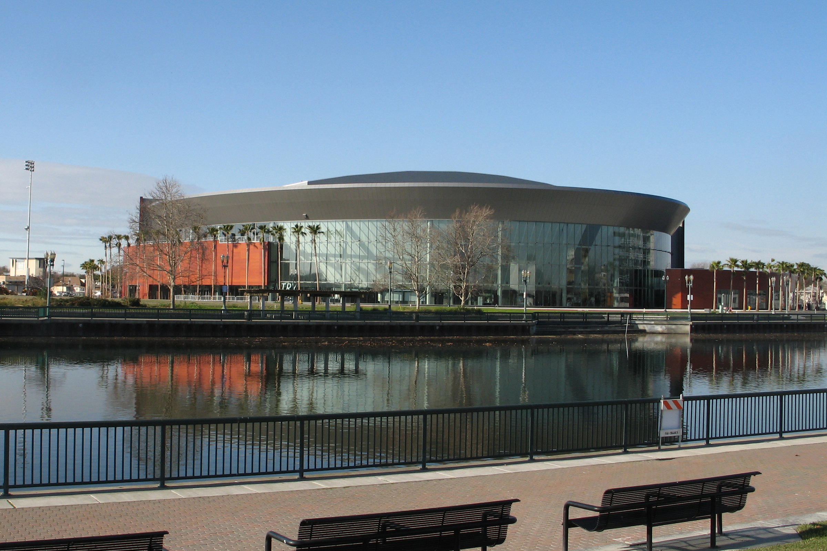
WIOA Implementation
Recertification of the Local
Workforce Development Board

Slide 26
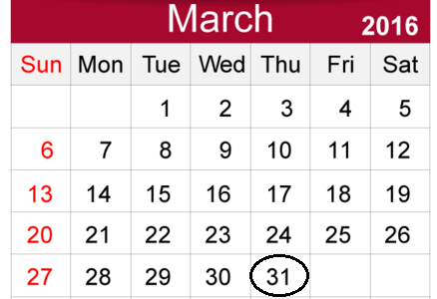
In Accordance with Directive WSD15-13
Local Workforce Development Areas were requested to Submit Their Application for LWDB Recertification
Applications for Board Recertification were due on March 31, 2016.
Moving up the tentative due date of June 30, 2016
Notes:
WIOA required the recertification of the Local Workforce Development Board.

Slide 27

The Recommendation of the Board
The establishment of a Workforce Development Board (WDB) in accordance with WIOA membership requirements; and
Nomination process consistent with the Act and WDB Bylaws.

Slide 28

Development of WDB Bylaws:
WDB Bylaws were Developed to comply with WIOA and Federal Requirements

Slide 29
Development of the Chief Local Elected Official (CLEO) Agreement
Between the WDB
The CLEO was developed to comply with WIOA and the Federal Regulations
Comparable to the existing Workforce Investment Board (WIB) document

Slide 30

On March 15, 2016
The San Joaquin County Board of Supervisors approved the recommendation of the WDB
And forwarded the Recertification Application to the State for final approval
WDB approval – February 24, 2016
Notes:
On February 24, 2016 The Workforce Investment Board unanimously voted to:
Establish a WDB in accordance with WIOA requirements.
Authorize the transition of WIB members to WDB members.
Approve the WDB Bylaws
Approve the Agreement between the WDB and the CLEO, authorize the chair to sign and forward to the BOS.
Approve the Local WDB Recertification request and authorize the Chair to sign and forward to the BOS for approval.

Slide 31
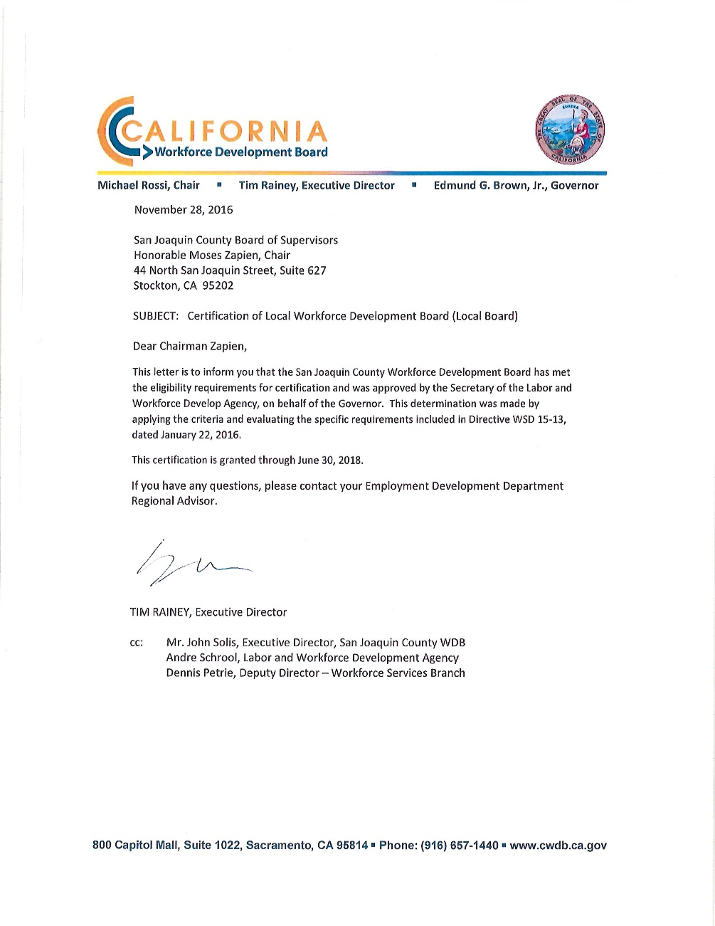
Final Approval was granted on November 28, 2016
The California Workforce Development Board sent the Final Approval letter Following the Appointment of a pending Labor Representative vacancy on the WDB
Notes:
On July 27, 2016
The CA Workforce Development Board notified San Joaquin County of it’s Conditional Approval

Slide 32
Procurement of WIOA
Youth Program Service Provider
The procurement of the youth program services providers required:
The development of a new procurement instrument
Containing the new program requirements
Must be Operational by July 1, 2017

Slide 33
WIOA Youth Program Procurement
Background
On December 20, 2016, Request for Proposal RFP #16-39 was released to solicit proposals from potential youth service providers to operate WIOA Youth Programs to serve eligible youth, ages 16-24, facing multiple barriers to education, training, and employment.
All proposals were due to Purchasing by February 20, 2017.
Eligible organizations had the opportunity to propose services to 100% Out-of-School Youth (OSY) or a combination of In-School Youth (ISY) and OSY resulting in a minimum 75% expenditure of WIOA youth funds on OSY.
Notes:
WIOA Youth Program Procurement
Background cont.
The WIOA Youth Program includes 14 program elements that are required to be made available to youth participants.
The WIOA prioritizes work experience activities through a 20% minimum expenditure rate requirement for the work experience program element.
Local programs funded as a result of the RFP would provide youth services in partnership with San Joaquin County Employment and Economic Development Department (EEDD) and under the oversight and direction of the WDB.
Work Experience and Supportive Services (two of the fourteen elements) will be provided by the EEDD.

Slide 34
WIOA Youth Program Contracts
California Human Development (CHD)
Awarded an amount not to exceed $660,000 for the
period of July 1, 2017 through June 30, 2020; and
San Joaquin County Office of Education (COE)
Awarded an amount not to exceed $2,640,000 for the
period of July 1, 2017 through June 30, 2020.
Total Funding $3,300,000
Approved by the Board of Supervisors on June 13, 2017.

Slide 35

HIRE ME FIRST INTERNSHIP PROGRAM
Operational since 2007,
the program is going on its tenth year of service to the Tracy community
Has experienced tremendous success
Recipient of National & State-Wide Recognition
Western Association of Chamber Executive (WACE)
Congressional Recognition by Congressman Jeff Denham

Slide 36
HIRE ME FIRST INTERNSHIP PROGRAM
In 2017 the HMF experienced tremendous growth with
over 1,036 students participating in its activities
707 students participated in Job Readiness Workshops
738 students participated in Mock Interviews
406 students completed an internship
325 students completed all of the program requirements and Received competency certification
Expanding into Manteca

Slide 37
SAN JOAQUIN COUNTY WORKNET
SUMMER JOBS 2017
Worked in Partnership with the Business Community at the Local Chambers of Commerce
  56 Job Preparedness Orientations
  1079 Participating Students
  781 Direct Placements
  1511 Total Job Orders

Slide 38
San Joaquin County WorkNet
Youth Employment & Training Activities
Youth Service | PY 2016 | PY 2017
Youth Served | 4,392 | 4,743
Youth Services | 6,378 | 7,862
Work Experience | 1,183 | 1,156
Job Placement | 931 | 1,422

Slide 39

Delivery of Career Services
Under WIOA
A Local Board may provide Career Services through a One-Stop Delivery System

Slide 40

San Joaquin County’s
Workforce Development Board
On February 22, 2017 the WDB unanimously approved its application to the Governor requesting approval to be a career services provider at its AJCC
Approved by the BOS on March 22, 2017
Submitted application by the date of March 1, 2017

Slide 41

California Workforce Development Board
Approved San Joaquin County WDB as a Provider
of Adult and Dis-located Worker Career Services
on April 27, 2017
According to CWDB Officials
The CWDB Agenda is their
Document Source

Slide 42

One-Stop Operator Procurement:
The Role of the One-Stop Operator
The Only Requirement:
The One-Stop Operator must coordinate the service delivery of the required One-Stop Partners and Service Providers.
Notes:
The WIOA Legislation required the procurement of the One-Stop operator.

Slide 43

One-Stop Operator Procurement There are a Variety of Options
Procurement of …
Multiple One-Stop Operators
A Single One-Stop Operator
A Mall Manager
A Regional Service Provider

Slide 44
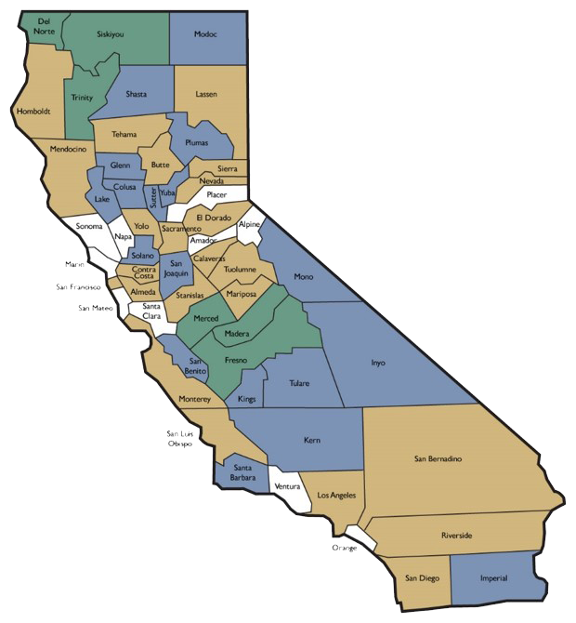
Regional One-Stop Operator
Northern Central Valley Sub-Region
Merced County
Madera County
Stanislaus County
San Joaquin County
Kings County

Slide 45

The Northern Central Valley
Sub-Region:
First Procurement
Closed on March 7, 2017
Generated no proposal
Second Procurement
Was released on March 22, 2017
Generated only one (1) proposal with limited experience

Slide 46

One-Stop Operator Procurement
Options:
Release an RFP for a third time
Sole Source Procurement
Submit for a waiver to be the designated One-Stop Operator (Temporary)

Slide 47
A Highly Recommended One-Stop Operator was ProPath
A seasoned One-Stop Operator
Consultant to CA Workforce Development Board
Extensive Workforce Development Experience
Staff: seasoned veterans with strong expertise on WIA/WIOA Statutory and Regulatory Requirement
Notes:
ProPath was asked to submit a proposal if it was interested in being the Region’s One-Stop operator.
Pro-Path’s Extensive Experience as One-Stop Operator’s
A procured One-Stop Operator for numerous LWDBs including Mother Lode and Kern County
Long Standing One-Stop Operator for Fresno, Tulare, and others
Special Projects Coordination for at least Twelve (12) other LWDAs
Staff are Consultants to CWDB
Convening of San Joaquin County Required Partners with ProPath
San Joaquin County WDB has scheduled A meeting for Wednesday, December 20, 2017 with required partners

Slide 48

San Joaquin County
Target Industry Sectors
In San Joaquin County and the Central Valley Region we have identified five (5) priority and target industries:
Manufacturing
Healthcare Services
Logistic Movement / Transportation
Agribusiness / Ag-Business
Construction

Slide 49
San Joaquin County’s
Business Retention & Expansion Program
Monitoring our Priority Industries
to support:
  Their growth and development
  Help them access available resources
  Eliminate barriers that impede their growth and development
  748 Business Visitations in 2016
  197 Service Referrals in 2017
  Over 3205 Business Contacts

Slide 50
Business Team San Joaquin
...Over 65 committed economic development professionals and business leaders who provide assistance to businesses located in San Joaquin County to help them grow and prosper
Membership
Higher Education
Chambers of Commerce
City and County staff
State of California
San Joaquin Partnership
Notes:
The Rapid Response Team
The Employment and Economic Development Department is the leading agency to engage all partner agencies:
SJC WorkNet
Economic Development Association*
State EDD
Municipalities
San Joaquin County
Partner Agencies
*Leading Agency to initiate contact with impacted businesses

Slide 51

San Joaquin County’s
Revolving Loan Fund
Established to promote job creation and job preservation by...
Promoting business expansion, retention & attraction
It stimulates Employment & Economic opportunities
Over $42 Million Loaned to SJ Businesses
$40 Million Private Capital Investments
3951 Job Created or Retained

Slide 52
The Rapid Response Team
The Employment and Economic Development Department is the leading agency to engage all partner agencies:
SJC WorkNet
Economic Development Association*
State EDD
Municipalities
San Joaquin County
Partner Agencies
*Leading Agency to initiate contact with
impacted businesses

Slide 53

Layoff Aversion Strategy
Braiding with BREP
Collecting pertinent Labor Market Information:
Hiring classification
Required skills sets
Hiring practices
Seasonality
Notes:
A Layoff Aversion Strategy
A critical part of an effective Rapid Response Strategy

Slide 54
Workforce Development Board
San Joaquin County WorkNet
Job & Resource Fairs – 84
  Major Job Fairs – 6
  Neighborhood Job Fairs – 78
  Number of Employers – 268
  Job Seekers – 31,200

Slide 55
San Joaquin County’s Comprehensive Economic Development Strategy (CEDS)
A 5-Year Planning Document
The intent is not to replace or redirect other efforts, But leverage their performance through an enhanced degree of integration
The CEDS must be consistent and complement the Economic Development Strategy of each Partner Agency
Include Infrastructure Projects
Submitted December 30, 2017
Notes:
Economic Development Association
Takes the leadership role in the development of…
San Joaquin County’s Comprehensive Economic Development Strategy (CEDS)
Supporting Infrastructure Development

Slide 56
Employment and Economic Department Association of San Joaquin County
Taking a Leadership Role and
Working in Partnership with its Community

